Slide 1
Compost Awareness Week 2019
Rod Weston
Master Composter
www.carryoncomposting.com

Slide 2
Household Waste

Slide 3
Compostable Waste

Slide 4
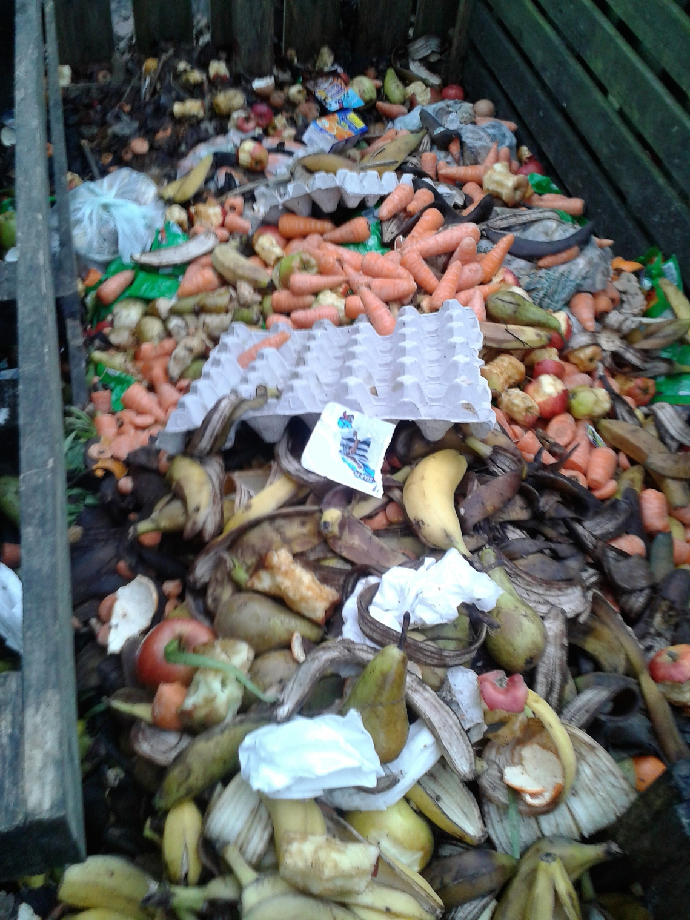
Waste Reduction should be the first priority
While composting is important the first priority should be to reduce waste.
This is a school compost bin showing some of the fruit and carrots provided as part of a Healthy Eating programme

Slide 5
Local Community Composting
You need not be alone:
Community Composting is often perceived as only the composting of garden waste, on a small scale, with a voluntary workforce and minimal technical input
Allotments or blocks of flats are ideal locations for community schemes.
Food Composting at pubs, cafes, residential homes

Slide 6
"I don't have a garden"
You don't need a garden to make and use your own compost.
Composting technology has caught up with modern, compact living: there are bins for large and small gardens and courtyards as well as indoor wormeries and Bokashi bins which are totally sealed.
Once the composting stage is over, you can add the compost to a window box, patio pots or use it on the garden.

Slide 7
Something for everyone
 | No outside space | Balcony only | Small Garden | Allotment/ large garden
Bokashi
Wormery
Plastic bin (Dalek)
Green Cone
Green Johanna
Pallet or wooden bins
Leaf mould
Balcony or no outside space: A combination of Bokashi and wormery could be used to process the maximum waste
Notes:
No outside space
Balcony
only
Small Garden
Allotment/
large garden
Bokashi
Wormery
Plastic bin (Dalek)
Green Cone
Green Johanna
Pallet or wooden bins
Leaf mould

Slide 8
Food waste composting
Food waste
Uncooked vegetables
Compost heap or bin incl. hot composters such as Hotbin, Johanna shown under "cooked food" below
Cooked vegetables, meat, fish, dairy & plate scrapings
Food composter e.g. Hotbin, Green Johanna, Joraform,
Green Cone Food Digester
Bohashi bins
Wormery ( not onion or citrus)
Trench , Sheet, Lasagne etc

Slide 9
Garden Waste Composting
Garden Waste
Mainly vegetables, flowers and annual weeds
Compost bin or heap
Trench , Sheet, Lasagne etc
Wood incl. logs tree stumps
Autumn leaves
Leaf mould using bin or bag
Hot Compost, Drown or bag until dead then compost
Perennial weeds
Mainly grass
Grass Boarding
Hugelkulture Mound, wood pile or shred & compost depending on size

Slide 10
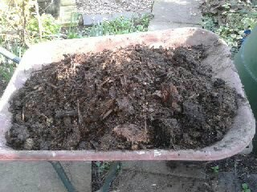
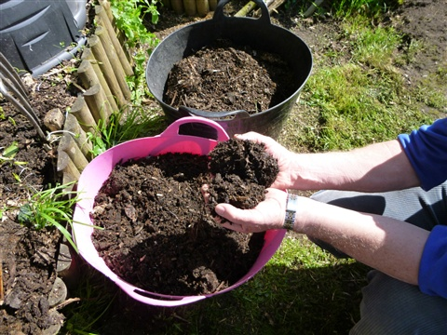
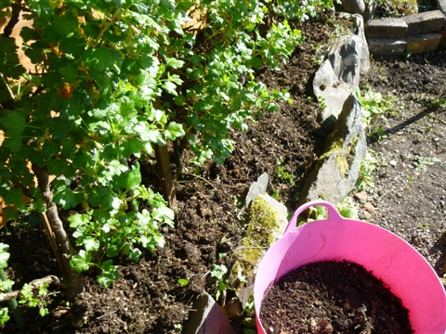
Composting
Composting is the aerobic decomposition of organic matter to producing .
Compost is rich in nutrients and is used as a soil conditioner, a fertilizer, which adds humus and humic acids to the soil.

Slide 11

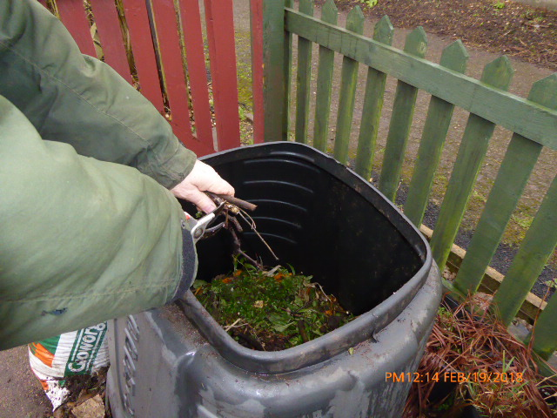
Water + CO₂ ₊ Heat
Organic materials
Plants & Food scraps
Air + Water
Microorganisms
Finished compost
Added to soil

Slide 12
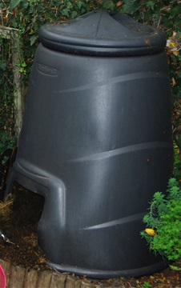
Composting can be easy
At the simplest level, the process of composting requires making a heap of wet organic matter such as leaves, grass, and food scraps, and waiting for the materials to break down into compost over after a period of 6 -12 months.
Most people start with a low cost bin purchased through a scheme run by Get Composting for the local council

Slide 13
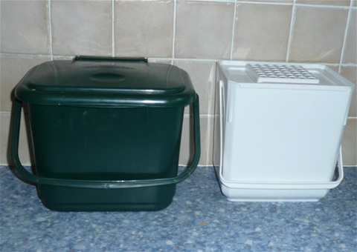
Uncooked kitchen waste
To avoid smells and frequent trips down the garden to the compost bin it is advisable to have a kitchen caddy that can be kept indoors.
There are a wide range of caddies available in plastic, pottery or metal.
The plastic caddies can be easily cleaned by putting in the dishwasher.

Slide 14
Greens and Browns
Organic material can be divide into Greens (high in nitrogen) and Browns (high in carbon)
For basic composting an equal mix of the two is required
If you go wrong it is easily corrected if the compost is wet and smelly mix in more Browns to dry add more Greens.

Slide 15
Greens
Grass cuttings
Raw vegetable peelings from the kitchen
Tea bags and leaves, coffee grounds
Young green weed growth – avoid weeds with seeds
Soft green prunings
Urine (diluted with water 20:1)
Comfrey leaves
Nettles
Animal manure from herbivores e.g. cows and horses
Poultry manure and bedding

Slide 16
Browns
Cardboard e.g. cereal packets and egg boxes
Waste paper and junk mail, including shredded paper
Bedding from vegetarian pets e.g. rabbits, guinea pigs – hay, straw, shredded paper, wood shavings
Tough hedge clippings and woody pruning's (shred)
Old bedding plants
Sawdust & Wood shavings
Fallen leaves can be composted but the best use of them is to make leaf mould

Slide 17
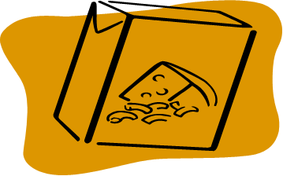
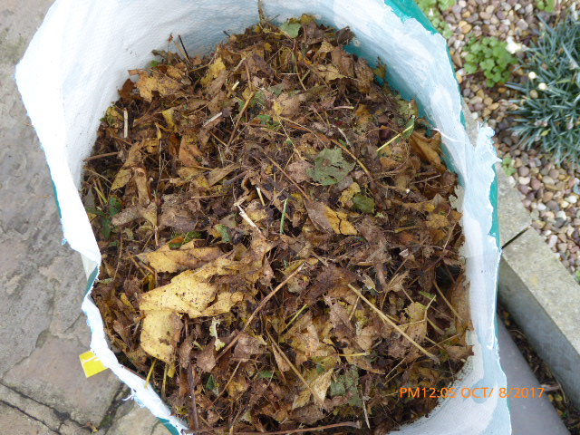
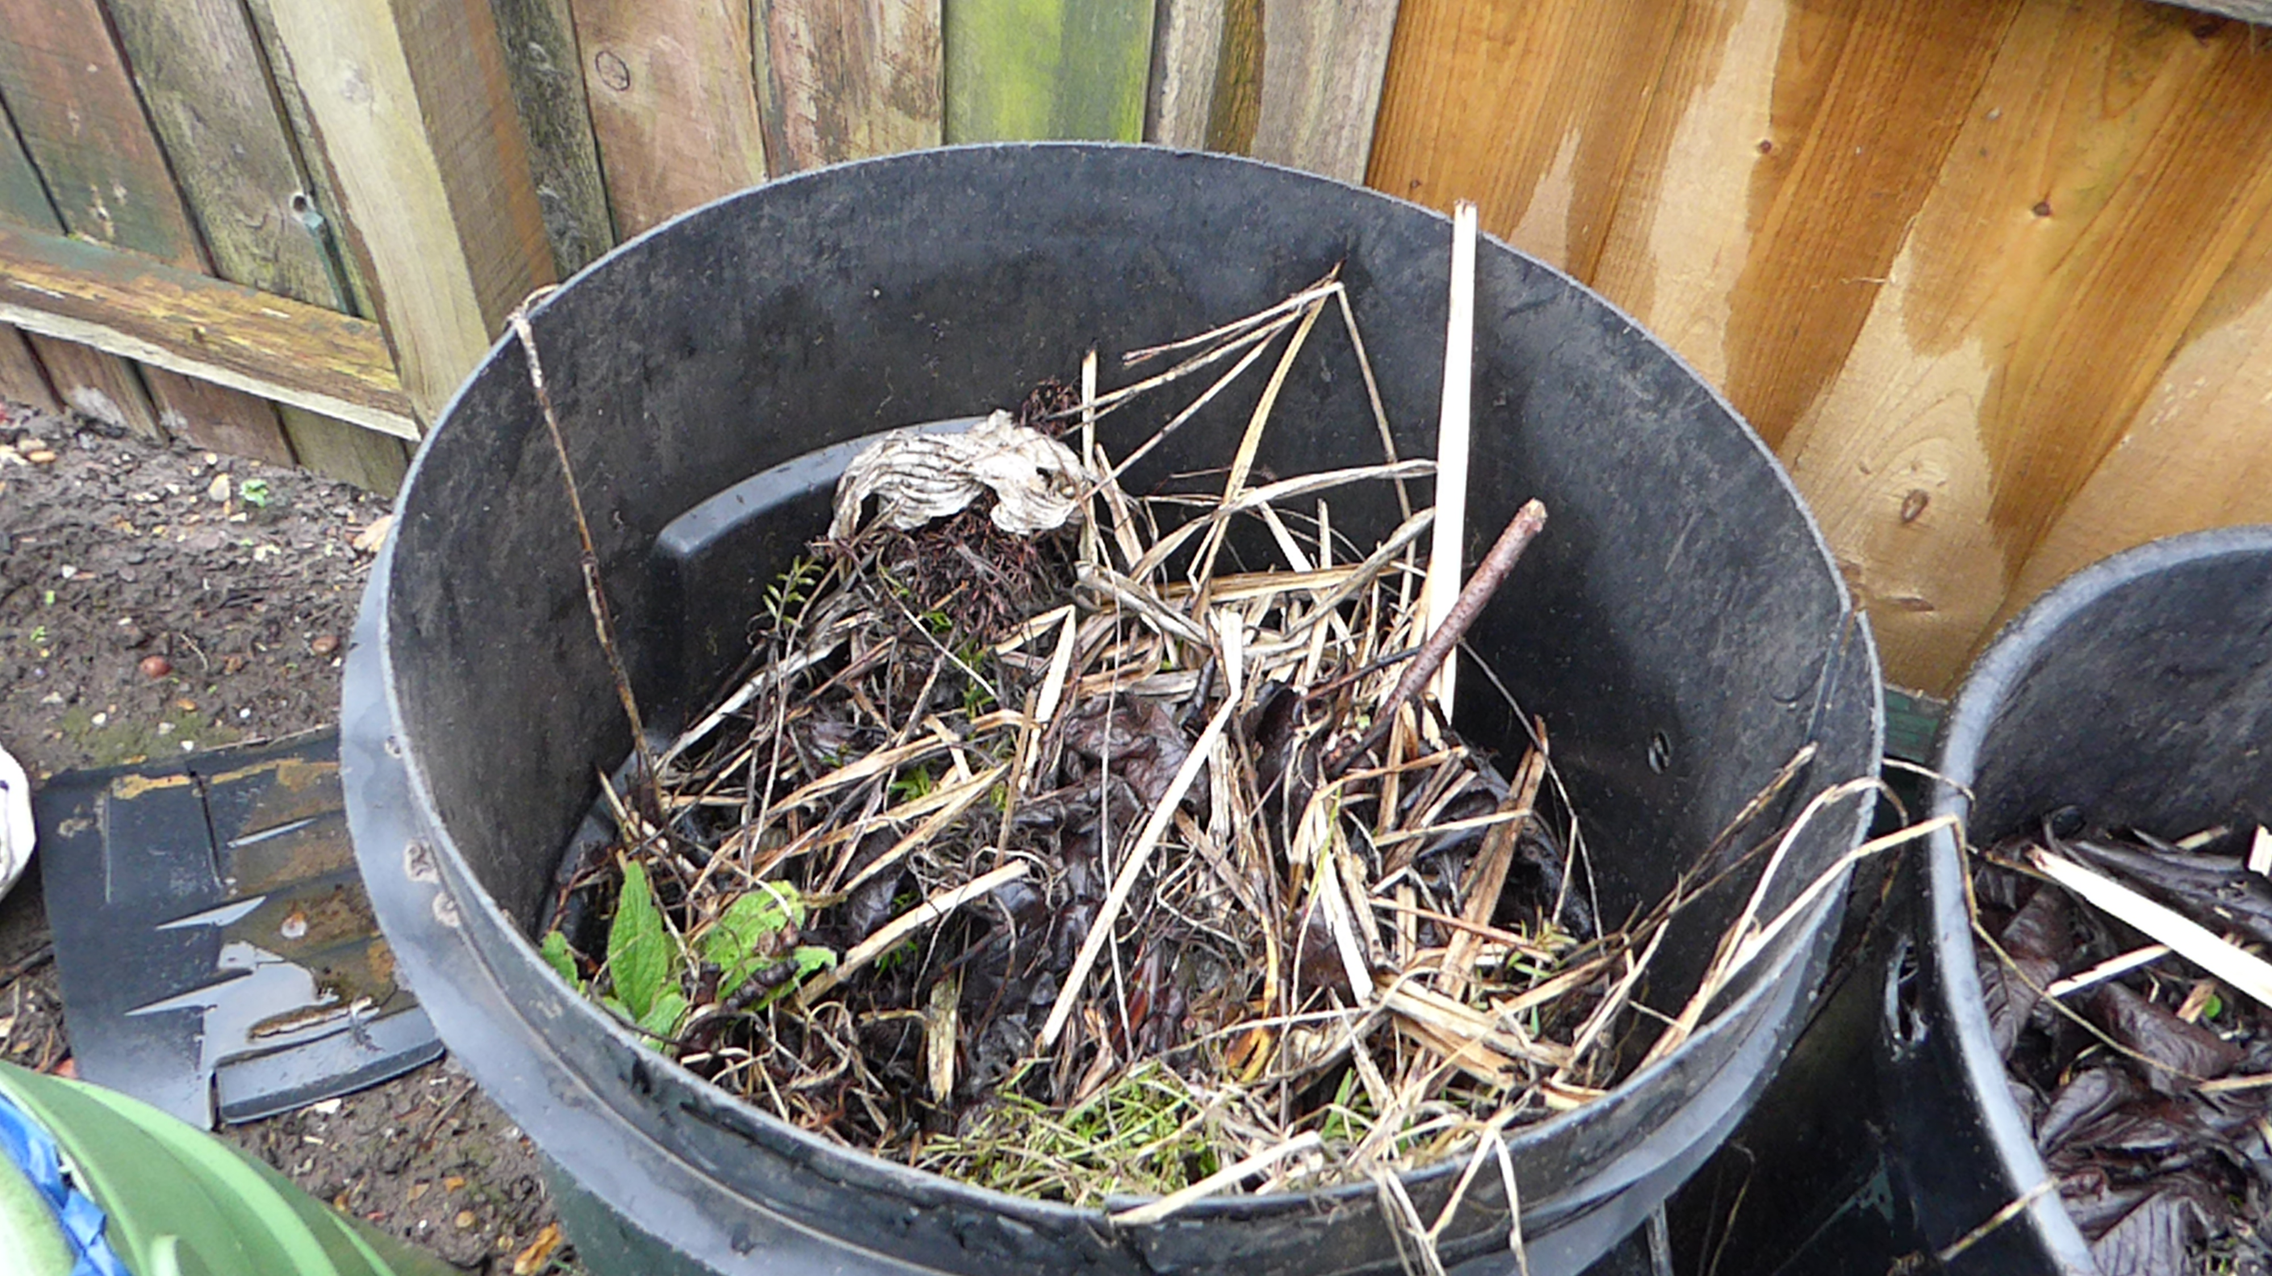
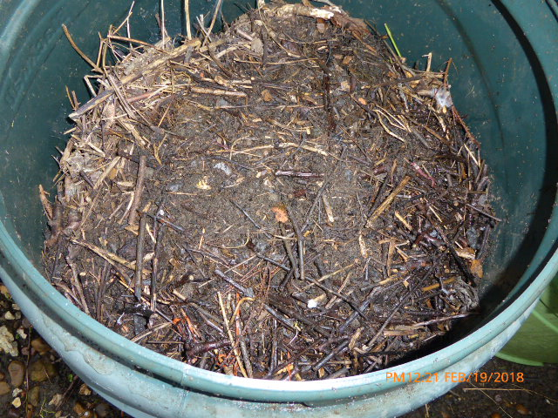
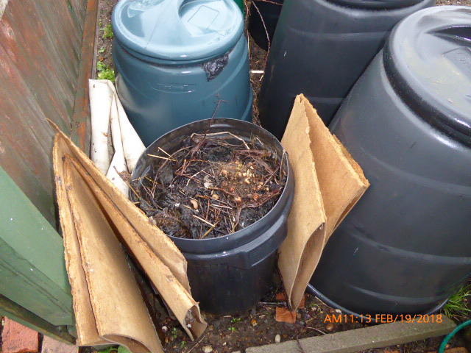
Browns
Browns can be saved for the winter or for batch composting

Slide 18

Other compostable items
Hair
Nail clippings
Egg shells - crushed & washed (?)
Natural fibres e.g. 100% wool or cotton
Wood ash (in moderation)

Slide 19
Can but!
Glossy magazines – although it is better for the environment to pass them on to your local doctors’ or dentists' surgery or send them for recycling
Newspaper – although it is better
for the environment to send your
newspapers for recycling

Slide 20
Do not Compost
Coal & coke ash
Cat litter
Disposable nappies
Meat , Fish and Cooked food can be composted in a special food composter such as a Hotbin, Green Johanna or Joraform

Slide 21
Cold Composting
Most people new to composting use a “cold composting” system adding material to the bin as when it becomes available
Start with a few woody plant stems or small twigs on the bottom first as this will improve the air circulation and drainage.
Add a layer of greens and browns at least 30cm deep.
Mix the greens & browns- scrunched up cardboard packaging e.g. cereal boxes straw, woody pruning's, this helps create air spaces within the heap.

Slide 22
Oxygen or Aeration
Oxygen is needed by microbes to breakdown the organic material.
Oxygen is available in air spaces within the composting material
Provided by:
Coarse material at base of pile – twigs, woodchips
Leaves, plant stalks, straw
Scrunched up cardboard, kitchen roll tubes
Aeration methods to encourage decomposition
Insert sticks while building pile then pull them out later
Perforated drainage pipe
Sunflower or artichoke stalks
Or Stir/turn weekly using a fork or aerator

Slide 23
When is it ready?
Cold composting may take a year - 18 months.
Compost can be made in as little as six to eight weeks or a year or more using “Hot composting” and tumblers but this involves more time and effort.
A simple test is to put a sample in a plastic bag, seal and leave for a few days.
When opened it should smell pleasantly of compost and not be horribly putrescent

Slide 24
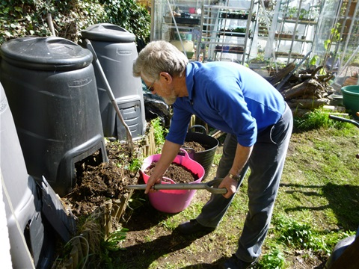
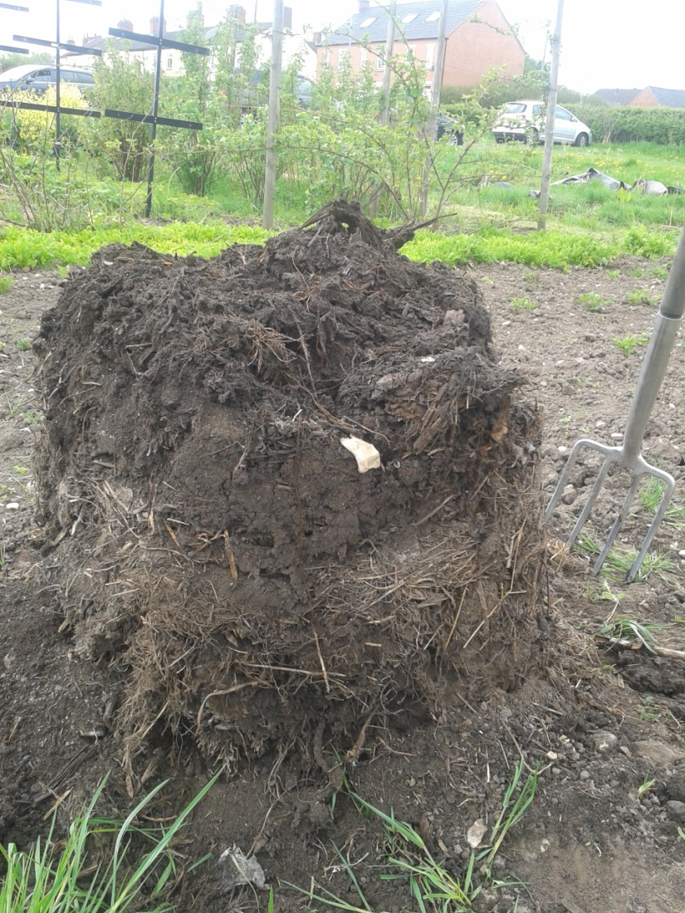
Harvesting the Compost
Harvest through the hatch or lift the bin of the composting material.
Return the top unfinished material to the bin to continue composting.

Slide 25
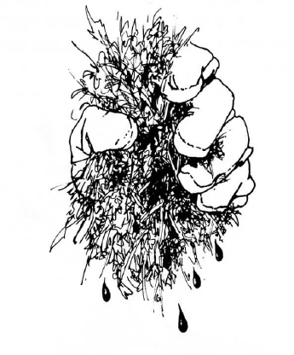
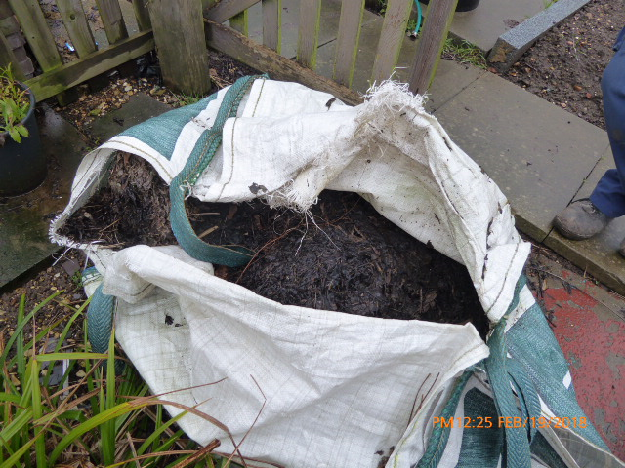
Finished product
Moist, dark brown, earthy smelling
Best left for a month or two to 'mature’.
Don't worry if it is lumpy, sticky or stringy, with bits of twig and eggshell still obvious, it is quite usable.
If necessary the compost can be sieved before use and any large bits put back into compost heap.

Slide 26
Using compost
Vegetable beds- Spread or dig in. 1 wheel-barrow per 5sq.m.
Flower beds- 5cm mulch or 10cm layer dug in before planting
Mulch- round trees and shrubs
Lawn feed- sieve and mix with sharp sand & spread up to 2.5cm thick
Top up pots and containers- top up
Compost tea- Soak compost in water. Dilute liquid 1/10 as feed add sludge to compost bin.

Slide 27
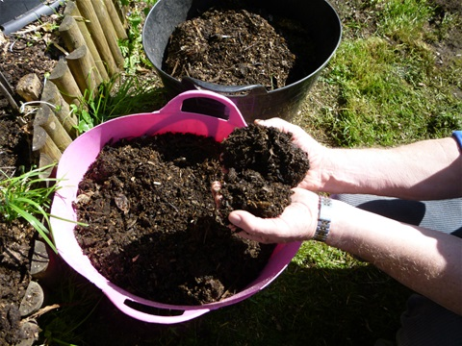
Use Compost Awareness week to help promote composting at home, on the allotment and in schools
Further details on composting can be found at
www.carryoncomposting.com

